Slide 1

A Brief Introduction of Software Architecture Research in China
国 家 自 然 科 学 基 金 委 员 会
National Natural Science Foundation of China
Presented by Software Architecture Group
Sep-27-2011

Slide 2
Agenda
Introduction
Founding Support
Basic Research and Program
Representation Research Groups
Conclusion

Slide 3








Cognition of SA
AW
DP
Dewayne Perry & Alexander Wolf
Processing, Data, Connection
Mary Shaw & David Garlan
Whole system structure design and description
Kruchten
Concept, Module, Running, Code
Hayes Roth
Function, connection, interface and relationship
David Garlan & Dewayne Perry
Evolution approach of Program/System
Barry Boehm
Software, system component, interactive and restriction
Bass, Ctements & Kazman
Software components, external behavior, relationship
DG
HR
MS
Kc
Kz
BB
Notes:
Since the late 1990s, the software architecture became a hot spot.
Dewayne Perry and Alexander Wolf think software architecture is a certain form of structural elements, namely a collection of components, including processing, data, and connection elements.
In Mary Shaw and David Garlan theory, the software architecture processes some structural design and description problems in the algorithm and data structure, such as global organization and global control structure, communication, synchronization and data access protocol, etc.
Kruchten thinks the software architecture contains four components:
Concept which describes the main components and the relation between themselves in the system
Module which contains the function decomposition and layer structure.
The running indicates the dynamic structure of the system.
Codes describe the organization between the variety codes and function library.
Hayes Roth said the software architecture is an abstract system specification which contains function, connection, interface and relationship.
David Garlan and Dewayne Perry think it a structure of program/system, and the relationship and the evolution approach with the time.
Barry boehm thinks the software architecture contains a component of software and system, and the interactive and restriction between them.
And Bass, Ctements and Kazman think that the software architecture includes a/ a group software components, the external behavior of these software components and relationship

Slide 4
Our Cognition of SA
Software architecture provides a high-level abstraction of structure, activities and properties for software system in reflection of the underlying platform and/or the application domain.
Description of system constituting elements
Interaction of elements
Model of elements guiding
Constraints of models
Notes:
In our viewpoint, the Software architecture provides a high-level abstraction of structure, activities and properties for software system.
It contains the description of system constituting elements, interaction between these elements, the model how to guide these elements and the constraints of these models.
The software architecture not only specifies the system’s organizational and topology structure, and also shows the system requirements and the correspondence between the elements which constitute the system. It offers some basic principles of the software design decisions.

Slide 5
Agenda
Introduction
Founding Support
Basic Research and Program
Representative Research Groups
Conclusion

Slide 6
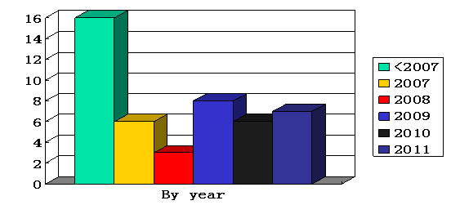
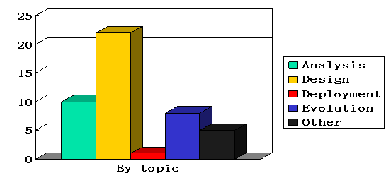
National Investment in Computer Science and Software Architecture
NSFC Funding for Computer Science(2001~2010)
NSFC Funding for Software Architecture(2001~2010)
Projects
2010
2009
2008
2007
2006
2005
2004
2003
2002
2001

Slide 7
International Cooperation and communication
By projects
By funding
Million RMB
International Cooperation and Communication Projects of NSFC

Slide 8
Agenda
Introduction
Founding Support
Basic Research and Program
Representative Research Groups
Conclusion

Slide 9
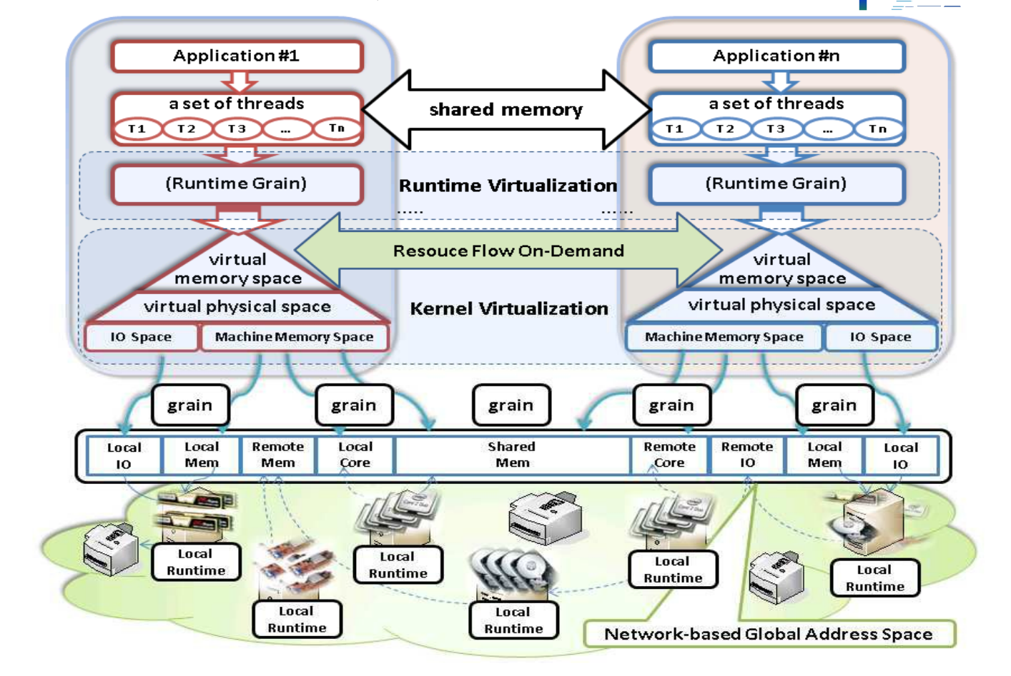
Credible computing environment based on Virtual machine architecture and credible software design
Notes:
Yuzhong Sun Institute Of Computing Technology Chinese Academy Of Sciences (2007)
Funding support: NSFC 2.5Million RMB
The project mainly focused on the research on the virtual space of credible capacity calculations. Multidimensional stream credible computing space model was proposed ,and the credibility on the space of flows can be achieved by the chain of credibility. This model can meet the requirement of multi-core and other new Internet services computing technologies.

Slide 10
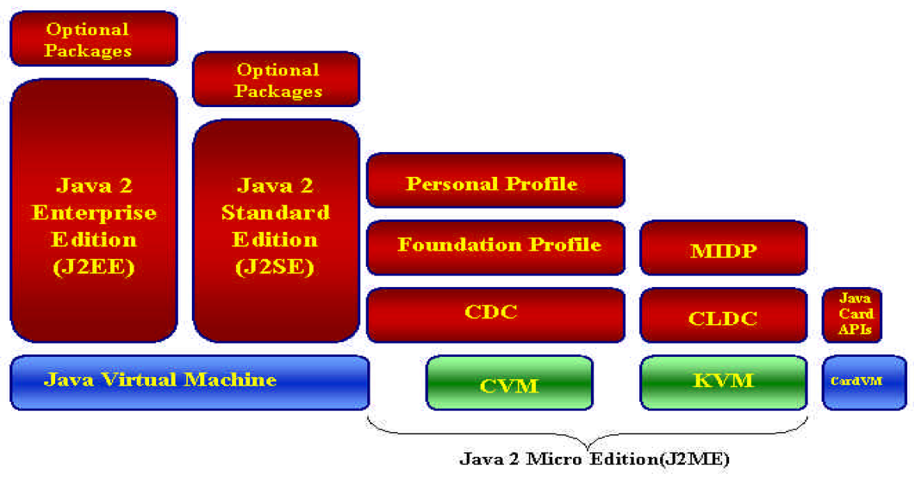
The new generation network middleware architecture, protocol and implementation mechanism
Notes:
Yan Jia National University of Defense Technology(2001)
Funding support: NSFC 0.5Million RMB
Combining with the characteristics of current network computing environment , the project team researched new generation middleware technology which is suitable for open and mobile networking environment. Some key challenges such as context-awareness, environmental adaptation, open coordination, service discovery and pervasive interoperability for new generation middleware were discussed in detail. Some real solution were showed in the project.

Slide 11
Agenda
Introduction
Founding Support
Basic Research and Program
Representative Research Groups
Shanghai Jiao Tong University
National University of Defense Technology
Peking University
Fudan University
Nanjing University
Conclusion

Slide 12

Representative Research Groups (1/5)
Shanghai Jiao Tong University
Focus: Architecture for Distributed Computing
Typical project
Key technologies of Compiler Optimization for on-chip Multi-core Processor
Computer Networks and Distributed computing Systems
Website: http://epcc.sjtu.edu.cn
Main publications:
IEEE TPDS，IEEE TC, TVC, CCPE, CIKM, WWW, JPDC, IPDPS, PACT, etc.

Slide 13
Compiler Optimization for on-chip multi-core processor
Multi/Many-core processor is the inevitable trend of development of processor, and has been applied in desktop, server and mobile and embedded system.
However, the power, memory and the parallelization of software limited the development of multi-core processor.
In this project, we studied several key technologies of the compiler optimization for on-chip multi-core processor:
Architecture of Multi-core Processor,
Acceleration Model
Compiler Optimization
Low-power framework and methods
Task Stealing Scheduling
etc.

Slide 14
Multi-core Processor Modeling
Scratch Pad Memory Model
Characteristic: Small-Capacity; low-power Consumption; high- speed access
Allocation strategy: Static Allocation; Dynamic allocation
Data Pipeline Model
Dynamic voltage scaling
Instruction-level speed modeling
Graphical data fetch modeling
Independence between DMA and CPU
Data Predictability from loop iteration
Power Cost Model
Quantify static power consumption
Quantify command power
Quantify power of cache and memory access
Multi-core communication power modeling
Basic model of McP

Slide 15
Multi-thread parallelization
Template Meta-programming method
Architecture of bi-tier task-stealing
Cycle of sentence migration transformation
Programming Model Overview
bi-tier task-stealing

Slide 16
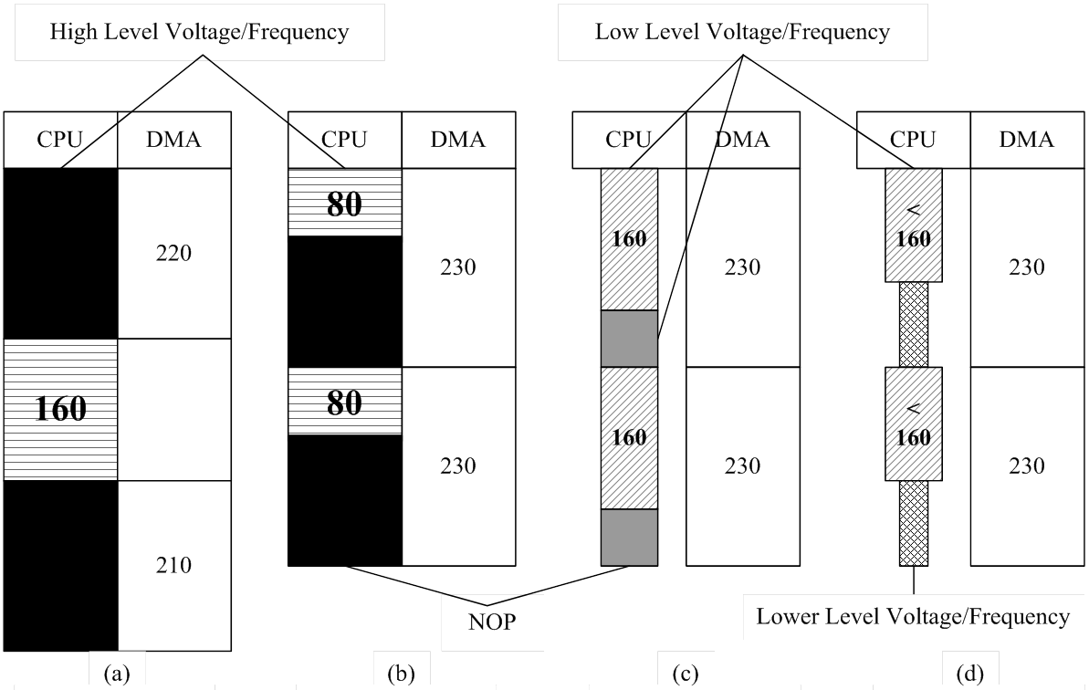
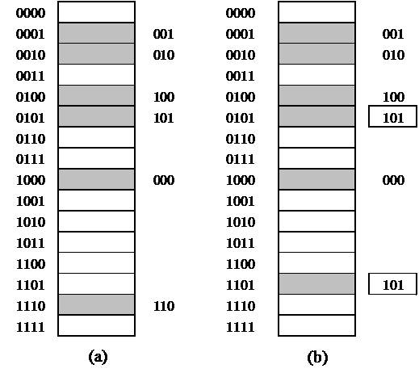
Compiler optimization and low-power-cost method
Space overlapping model
Data pipelining
Voltage power adjusting
Power Reduction Structure
Label compression
Without Data
Pipelining
With Data
Pipelining
With Data
Pipelining
With Data
Pipelining

Slide 17
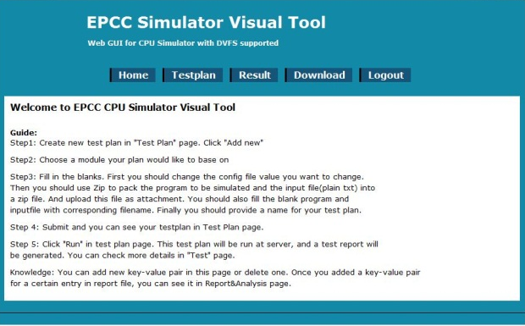
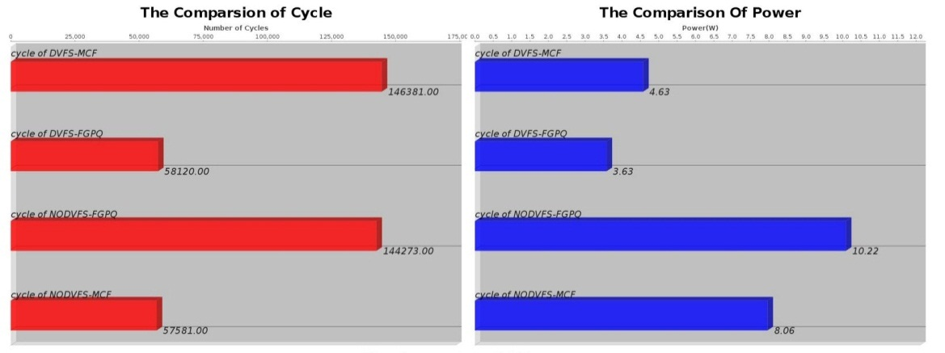

Multi-core simulation tools
http://epcc.sjtu.edu.cn/EPCC_SESC.htm
Add DVFS instructions
Calculate DVFS power using Watch model
Provide three Benchmark examples
Web-based visualization, user-friendly

Slide 18
Distributed Architecture for multi CPU & GPU cluster
GPGPU computing becomes more and more popular, traditional distributed systems can no longer ignore the computing power of GPUs.
GPU’s basic computing model is SIMD, which makes it very suitable for data intensive, loosely coupled computing.
Distributed system architectures still need much users’ attention when using GPUs for computing. Many problems including scalability, easy user interface, hardware and software configuration, etc. need to be solved.

Slide 19
Distributed GPU parallel computing system
The architecture of distributed GPU system contains three layers
System layer
System interface layer
User programming module level
Major
Mating
Related
I/O API
Application library
User
Layer
system
Interface
Layer
Web input Module
File input Module
GPU
Comp
Mod
GPU
Sched Mod
GPU
Comm
Mod
CUDA
Run
LIB
Err
Tole Mod
Err
Rec
Mod
Dist
File
System
System
Layer

Slide 20
Flow chat of System Layer
Provide compiler and optimization for GPU, task distribution, task scheduling and task return
User GPU Code
Code Optimization and Compiling
Task Dispatching
Task Running and Scheduling
User Programming
Model
GPU Compile
Model
GPU Task
Scheduling
GPU Communication Module
Distributed computing system for GPUs

Slide 21

Representative Research Groups (2/5)
National University of Defense Technology
Focus: High-performance computer system software architecture
Typical project
Key technology of petascale computing system
Website: http://www.nudt.edu.cn
Main publications:
IEEE TC, TPDA, TACO, ISCA, PACT, PPOPP, ICDCS, IPDPS, Hoti, Science in China, JCST…
Scientific Research Directions
High Performance Computing
Micro-processors
System Software
Network and communications

Slide 22
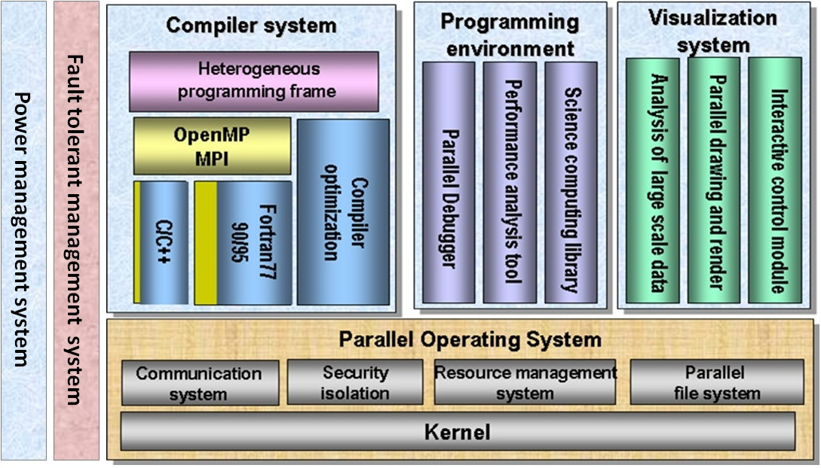
Some mature technology and application
HPC system software stack

Slide 23
Resilience computing Framework
Capability to support post-petaflops and Exascale computing
Collaboration with whole system software stack
Coherent fault detection
Coordinate fault tolerant decision
Cooperation of multiple fault recovery mechanics
Combination of proactive and reactive strategies
Customizable fault detection, prediction and recovery approaches
Support various parallel models
Energy
Climate&
Environment
Bio-physic
CFD
Applications
Animation
……
……
Application Programming Infrastructure
Checkpoint
Redundant computing
Re-computing
Process migration
Message log
……
Fault Tolerant Mechanisms
……
FTE
Fault Tolerant Engine
OS
File system
Compiler
RMS
MPI
……
Software Stack
……

Slide 24
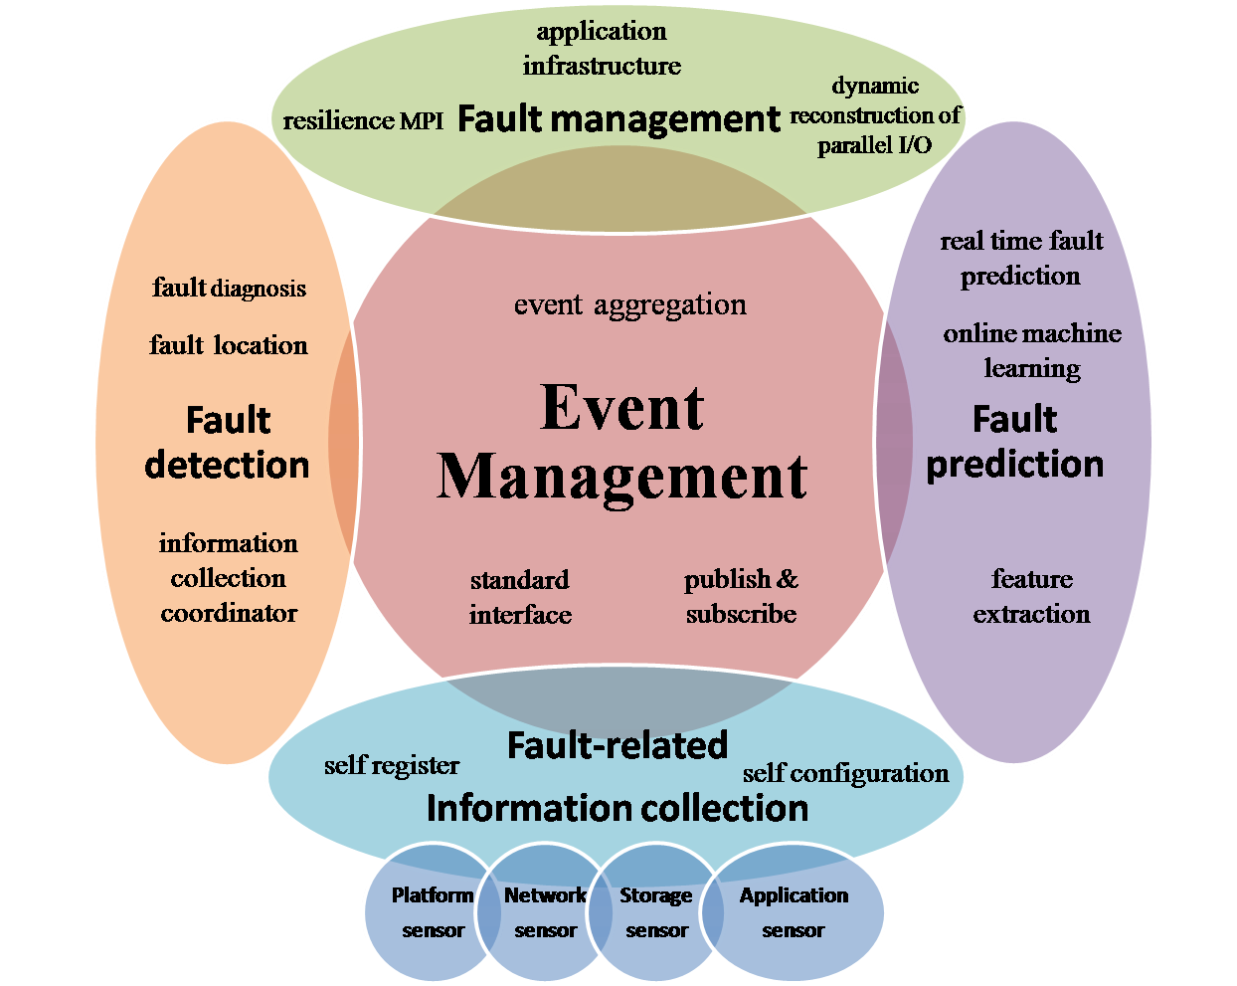
Resilience computing Framework
Fault tolerant engine
Fault related information collection based on sensors
Fault detection based on rules
Fault prediction based on machine learning
Event management based on publishing and subscribing
Scalable and low-overhead fault-related information sharing and distribution
Coherent fault detection and fault location
Online learning and real time fault prediction

Slide 25
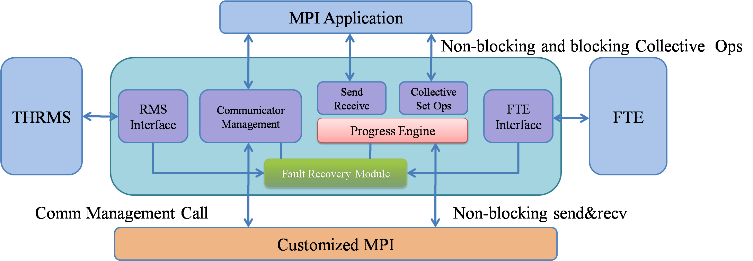
Resilience computing Framework
NR-MPI
Integrated with existing MPI (MPICH/OpenMPI)
Relay on FTE providing failure information of nodes, processes, and network
Reconstruction of broken communicator
Recovery of ranks’ connections
Provide non-blocking fault tolerant collective operations
Provide flexible data recovery mechanisms, CR/Redundant computing/APP

Slide 26
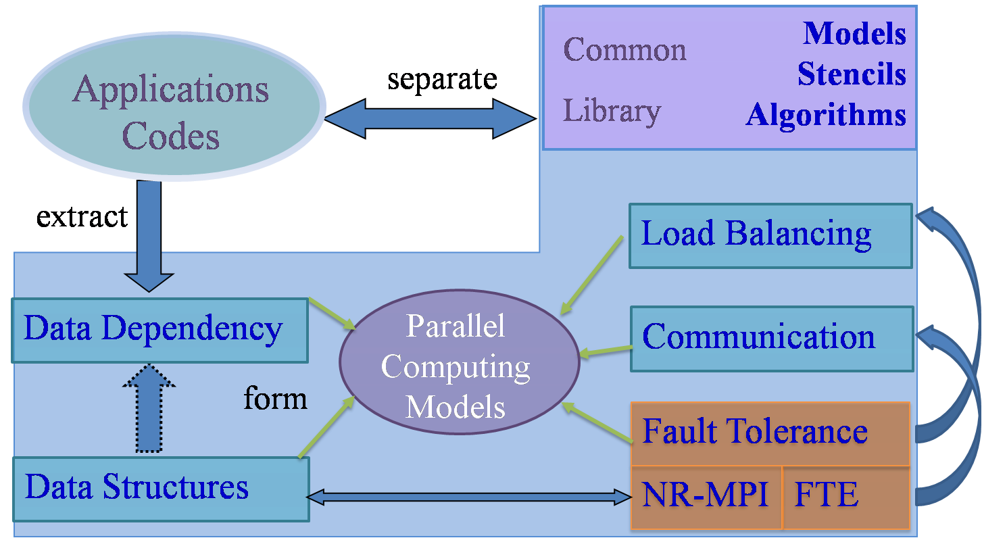
Resilience computing Framework
Application transparent Resilience Computing
Domain-specific Application programming Infrastructure
Domain scientists: focus on physical problem, algorithm, parameters
App-Infrastructure: handles parallelization, message passing and resilience
Application transparent Resilience Computing
Now for Jasmin
Potential fault tolerance pillar for multiple domain-specific application Infrastructures
Future for others

Slide 27
Large-scale Hybrid Tiered File System Architecture
App Layer
IO Capability Requirement
IO Capacity Requirement
Reliability Requirement
Availability Requirement
Service Layer
Posix IO Interface
Parallel IO Interface
HTTP
FTP
MPI-IO
Unified IO interface
Layout
Scheduling
Consistency Maintenance
Unify Layer
DHT
HA
RR
Strong Consistency
Stripe
Rep
ALU
Affinity
Weak Consistency
Data Management
FS
Interface
Local Storage
Migration
EXT
FAT
Logic Layer
Remote Storage
Compress
Lustre
Shared Storage
Encrypt
NFS
NTFS
Backup
Dedup
Storage Layer
SSD
SATA
SAS
FC
RAID
SAN
NAS
Capability to support post-petaflops and Exascale computing
Scalability to achieve >1TB/s I/O bandwidth by leveraging spatial locality
Applicability for supercomputers and clusters with hybrid infrastructure
Usability by federating multi-level storage into unified name space
Flexibility by key components re-configuration for application optimization

Slide 28
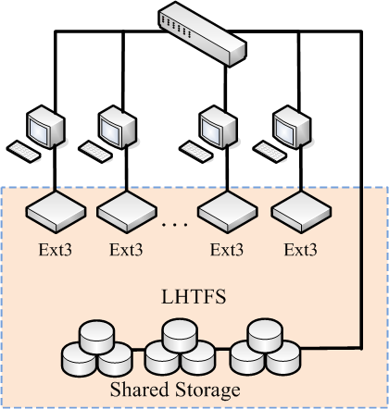
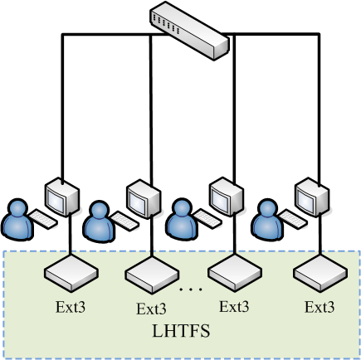
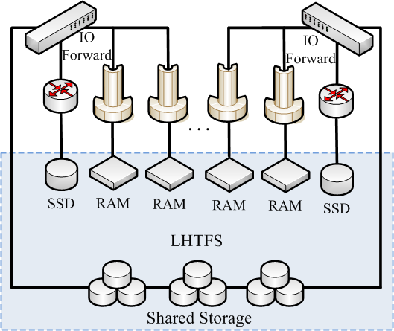
Large-scale Hybrid Tiered File System Architecture
Supports multiple tiers of storage devices and various configurations
Exploits the features of local storage to improve the overall I/O performance in the case that both local storage and shared storage exist in HPC system
Achieves IO forwarding by modifying node settings in the complex system configuration
Acts as a normal distributed File System in the system without shared storage

Slide 29
Large-scale Hybrid Tiered File System Architecture
Key Technologies
Affinity scheduling to explore full potential of spatial locality
Combination of centralized and decentralized metadata management
Zoning and connecting on demand to reduce resource contention
Relaxed data consistency control mechanism
Vertical optimization through I/O path
Redundant data management
Smart data migration across storage levels
API
POSIX-compliant UNIX file system interface for ease of use
Custom API to boost app I/O access with weak consistency
SDK for third-part interface support

Slide 30
Large-scale Hybrid Tiered File System Architecture
Experimental Results
Petroleum seismism data analysis: Typical DISC Application
LHTFS used, Double tiers( Local disks + shared THFS)
SRLW can reduce the overall IO time by around 50% than traditional SRSW
Scalable I/O capability, LRLW I/O time is almost a constant

Slide 31

Representative Research Groups (3/5)
Peking University
Focus: Architecture-Based Composition
Typical project
Theory and methodology of agent-based middleware on Internet Platform
Research on Networked Complex Software: Quality and Confidence Assurance, Development Method, and Runtime Mechanism
Website: http://sei.pku.edu.cn
Main publications:
ICSE, FSE, ICWS, COMPSAC, CBSE, IEEE TSC, ASE, JSS, IJSEKE, JSM, SSM, Science in China, JCST…

Slide 32
ABC Technical Framework
Feature Oriented Requirements Analysis
Design of Software
Architecture
Architecture Based Component Composition
Architecture Based Application Deployment
Architecture Based Maintenance and Evolution
FMTool (Feature Modeling Tool)
ABCTool (Architecture Modeling Tool)
PKUAS (J2EE-compliant Middleware)
Proposed in 1998
Introduces software architectures into each phase of software life cycle
Aims for automated component based reuse
Evolved to Internetware from 2002
Supports openness (extensible ADL), dynamism (runtime software architecture), changeability (self-adaptive architecture) and autonomy (autonomous component)

Slide 33
Feature Oriented Modeling
Treats features as the basic entities in the problem space.
A feature describes a software characteristic from user or customer views, which essentially consists of a cohesive set of individual requirements.
Uses features and relations between features (feature model) to specify the problem space.
Problem space
Feature
Relation between features
Feature-oriented view of the problem space
Notes:
1 The feature-oriented approach to requirements modeling treat features as the basic entities in the problem space,
and use features and relations between features (namely, feature model) to specify the problem space.
2 A feature describes a software characteristic from user or customer views, which essentially consists of a cohesive set
of individual requirements.

Slide 34
Software Architecture Modeling
Domain Feature Model
Application Feature Model
Draft Software Architecture
generality
Platform independent
Platform specific
Product specific
Design View
Implementation View
Deployment View
Runtime View
Meta Model of ADL
The meta model of ADL only defines the elements common to all views and necessary for traceability

Slide 35
Architecture based Deployment
generality
Platform independent
Platform specific
Product specific
Design View
Implementation View
Deployment View
Runtime View
Meta Model of ADL
Online Maintenance and Evolution
very valuable for large-scale distributed systems and 7x24 (7 days 24 hours) high availability
But very challenging to why, when, what & how
ABC’s Runtime Software Architecture Leverages
Software architecture knowledge for why, when & what
Middleware adaptability for how

Slide 36
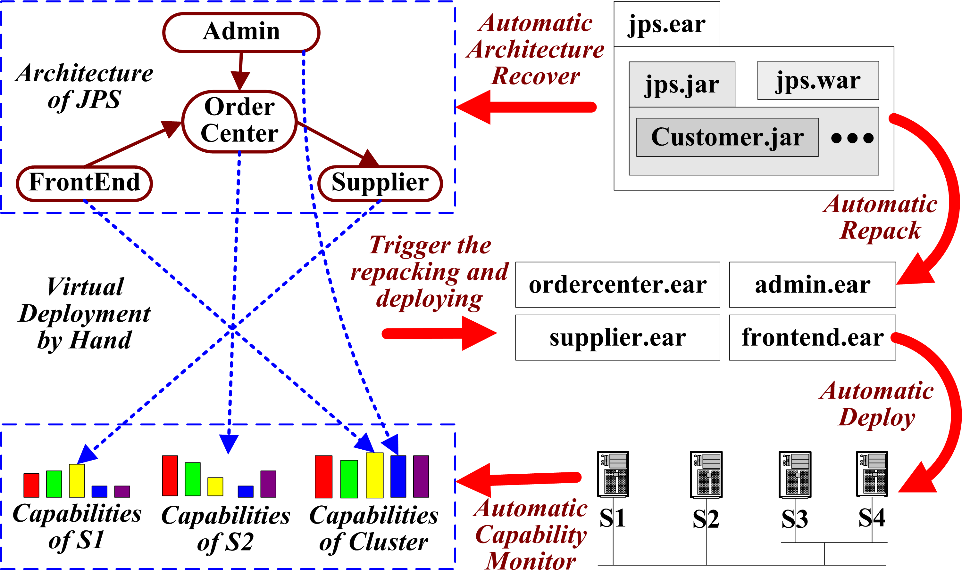
Architecture based Deployment Process
1
2
3
4
1

Slide 37
Architecture based Maintenance and Evolution
generality
Platform independent
Platform specific
Product specific
Design View
Implementation View
Deployment View
Runtime View
Meta Model of ADL
Online Maintenance and Evolution
very valuable for large-scale distributed systems and 7x24 (7 days 24 hours) high availability
But very challenging to why, when, what & how
ABC’s Runtime Software Architecture Leverages
Software architecture knowledge for why, when & what
Middleware adaptability for how

Slide 38
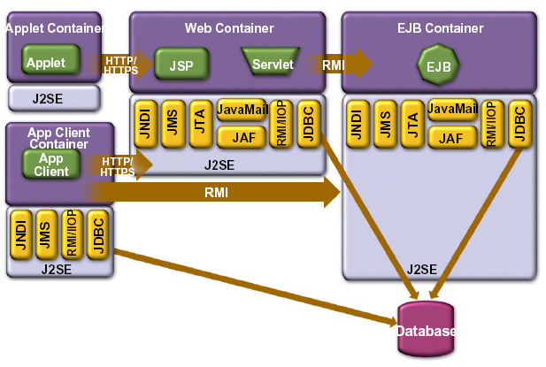
Runtime Software Architecture
Runtime Software Architecture
A model representing a runtime system as a set of architectural elements which are causally connected with the internal states and behaviors of the runtime system
Causal connection means changes at one side will immediately lead to the corresponding changes at the other side, and vice versa
Self
Representation
by Meta Objects
Notes:
刘英: 如何能够知道一个运行构件与其他构件之间的关系？如何保证正确性？性能开销？

Slide 39
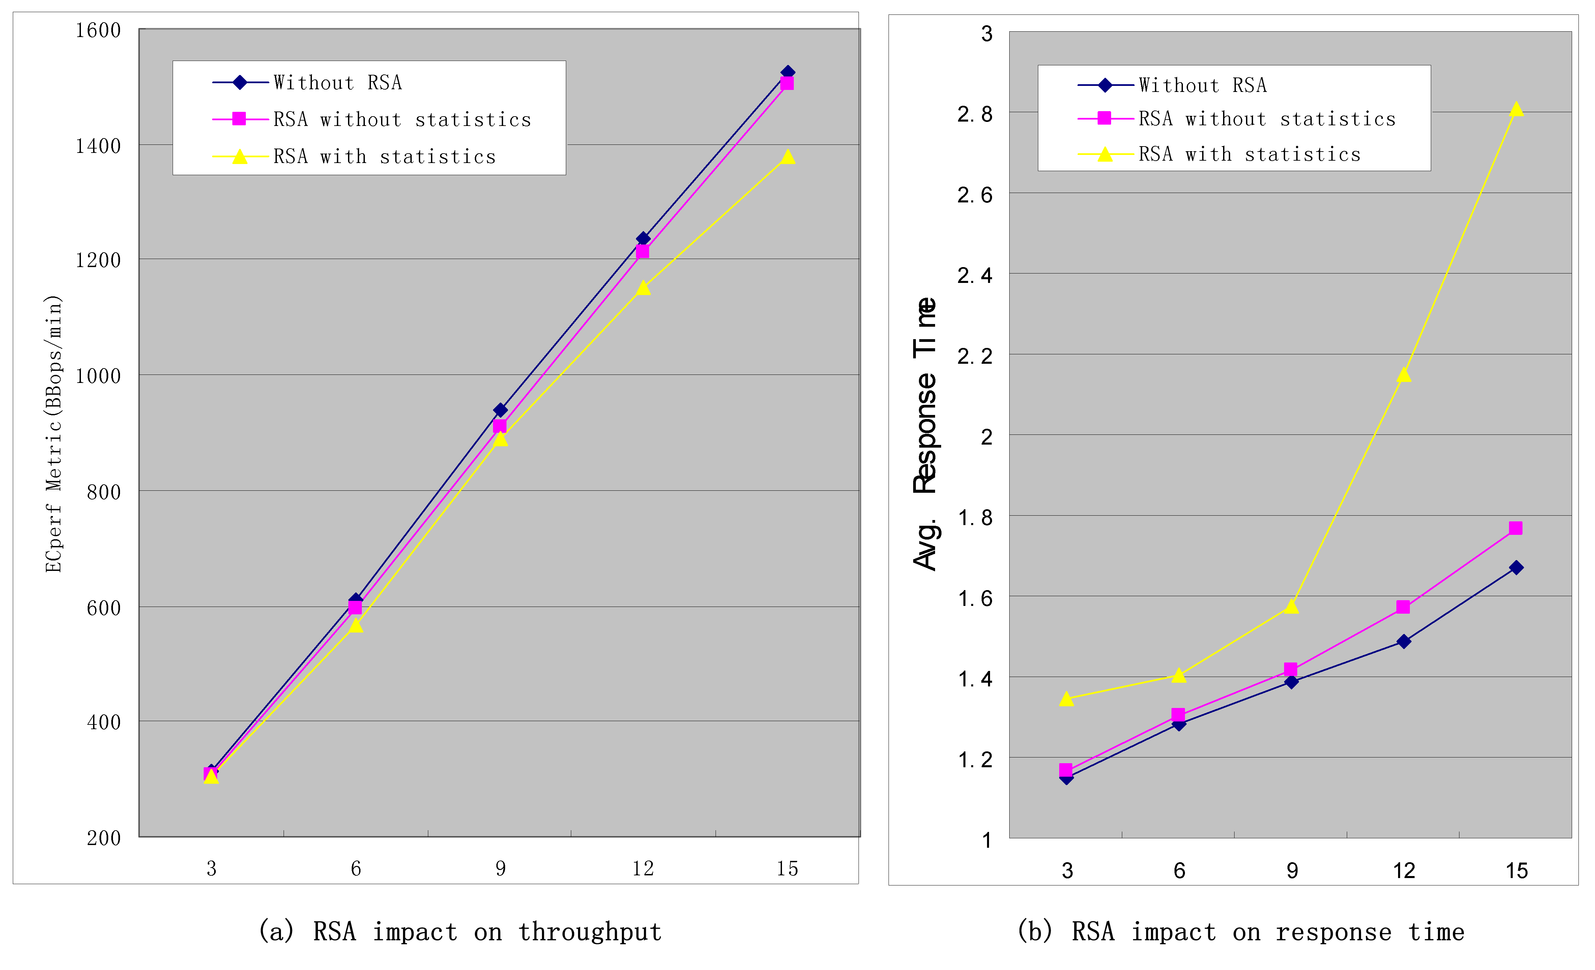


Architecture based Reflective Framework
Reflective Programs
Reflective GUI
Reflective APIs
Formal Description of SA
AppSA Specific Meta Entities
Correctness and Security of Reflection
Application SA
Causal Connection
PlaSA Specific Meta Entities
Causal Connection
Platform SA
Base Entities
Refine
SA in
Development
Reflective Middleware Based System
Deploy
Acceptable performance penalty

Slide 40
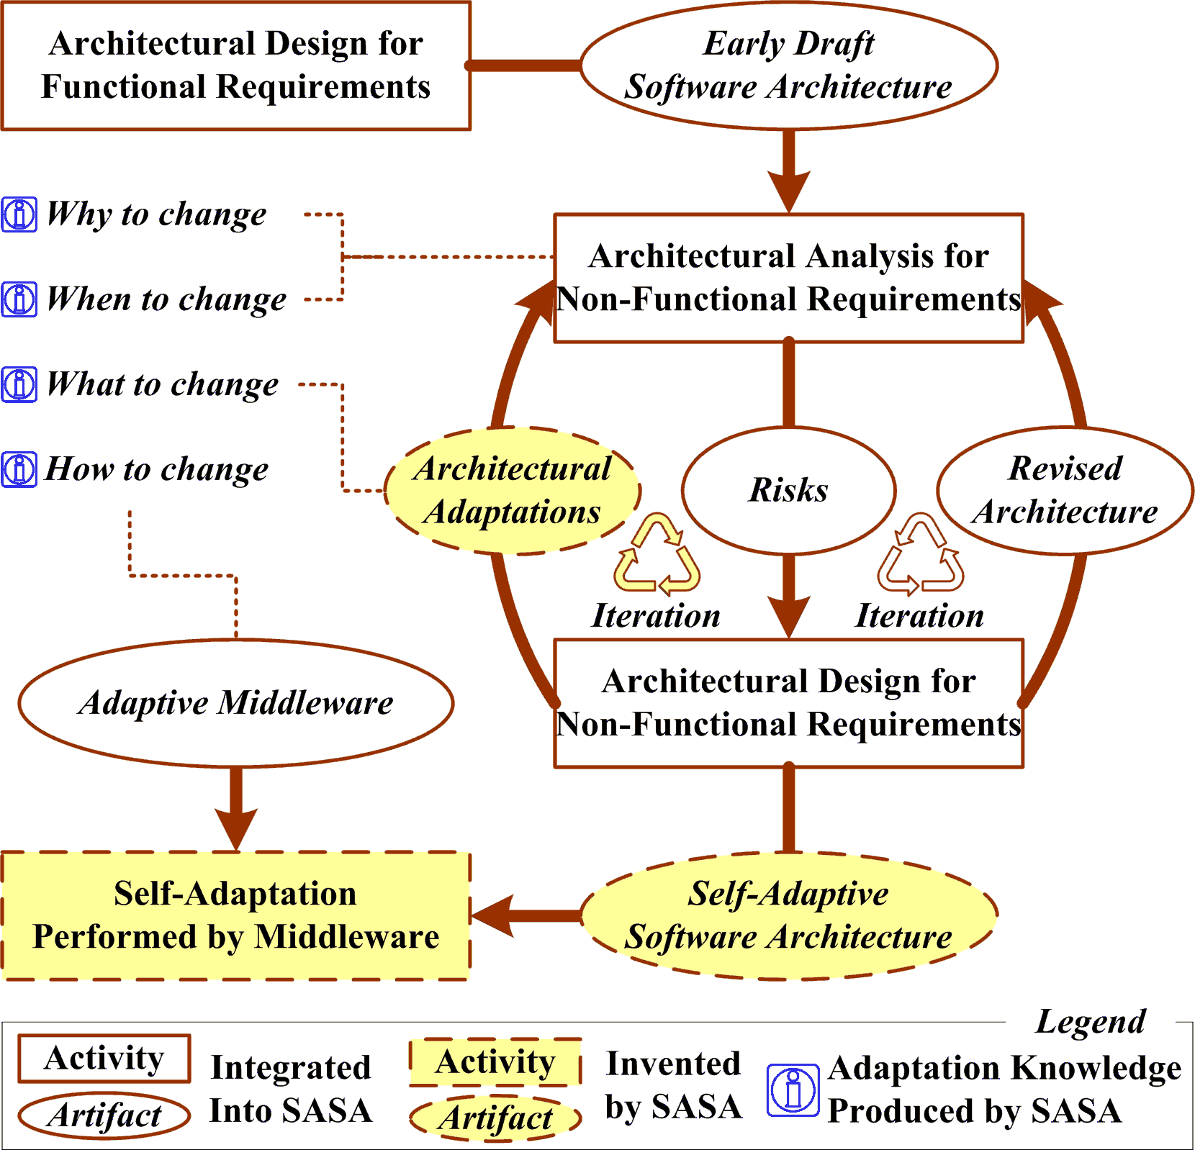
Self-adaptive Software Architecture
SA Decision
SA quality analysis & design
Dynamic SA
Runtime SA
SASA:
Leveraging SA achievements and experiences for enabling SA self-adaptive
Note: SASA can be started at runtime
Notes:
Firstly, the SA model should be analyzed to ensure the desired functionalities and qualities; otherwise, the SA model should be modified or refined before starting the self-adaptation modeling. During the modification, if the architects find that it is difficult to design a static SA that can achieve the desired functionalities or qualities, it implies the necessity of self-adaptation modeling. The self-adaptation modeling may or may not change the SA model violently. If involved components can be designed as autonomous component which can fulfill the requirements, it is unnecessary to modify the topology of the SA model. For example, if some autonomous component is capable of processing requests according to their priorities, surely it can also satisfy such requirement that the response time should be varied according to the priorities of requests. However, if the involved component cannot be designed as autonomous, or the autonomy is not enough to achieve the desired functionalities or qualities, then it is necessary to figure out a proper self-adaptation policy. Usually, there are two ways to design the self-adaptation policy. One is to clarify what should be done for adaptation, including the triggering conditions, the addition or deletion of specified components or connectors. This is appropriate when only part of SA needs to be adapted. The other is to prepare several SA candidates, each of which satisfies certain functionalities or qualities. These SA candidates are switched at runtime according to the desired functionalities or qualities. The above two ways may be combined to produce a more complex self-adaptive SA. Once the SA model satisfies all desired functionalities and qualities (otherwise, the requirements may be modified), it can be implemented by component composition and deployed into a proper execution platform. The execution platform for self-adaptive Internetware should have sufficient self-adaptation mechanisms, such that it can monitor the runtime information and adapt the runtime SA accordingly. In short, ABC locates the part of Internetware that requires self-adaptation through SA analysis, determines when and what should be done for self-adaptation by SA design, records strategies for self-adaptation in DSA, and interprets these strategies by means of autonomous components or reflective middleware.

Slide 41

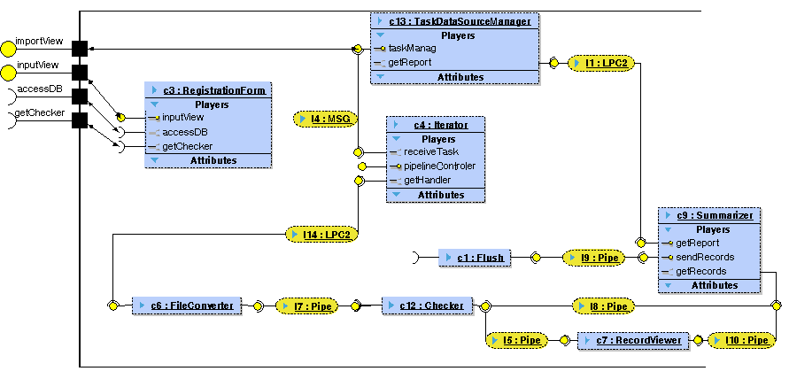
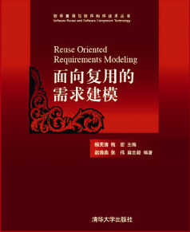
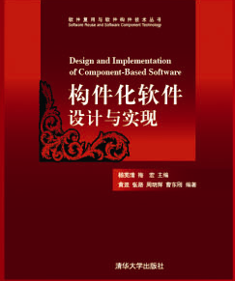
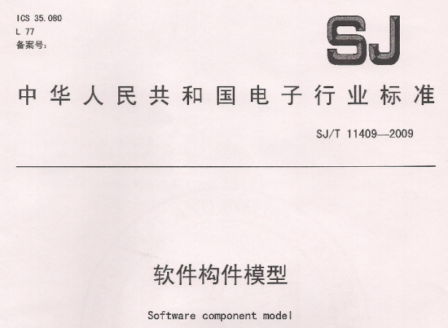
ABC Dissemination
Real Applications
Information System Modeling of Beijing Olympic Games 2008
Credit Management Modeling of China XXX Bank
Training & Education
Reuse Oriented Requirements Modeling (book)
Design and Implementation of Component-based Systems (book)
Solution Engineering (courseware with IBM)
Standardization
Leading Componentization Standard Series of China IT Industry from 2005
Release Software Component Model Specification in 2009

Slide 42
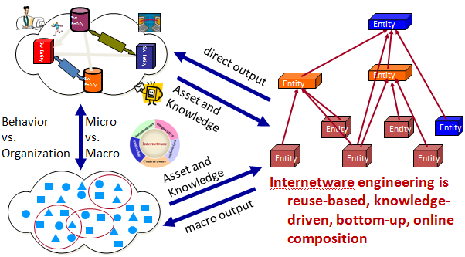

ABC Future
Open Source as Eclipse Plug-ins
An extensible and customizable integrated engineering environment
Support Internetware
A new software paradigm of Internet as a Computer
Design decision in architecting
Software architecture documentation with rich knowledge
Software architecture at runtime for high confidence
cooperative
situational
emergent
autonomous
evolvable
trustworthy

Slide 43

Representative Research Groups (4/5)
Fudan University
Focus: adaptive architecture
Typical project
Research of Confidence requirement model based adaptive fault-tolerant software architecture
Website: http://www.se.fudan.edu.cn
Main publications:
ICSE, ICSR, QSIC, RE, SEKE, COMPSAC, CSMR, Journal of Software, ….

Slide 44
Self-Adaptive Architecture
Self-Adaptive Systems: systems that can adapt their structures and behaviors at runtime for
changing requirements
changing environments
Architecture-based Self-Adaptation
reconfigurable architecture as the basis of adaptation decision making and execution
architecture model as knowledge base for adaptation decision
architectural reflection keeps the causal connection between meta-level (model) and base-level architecture (runtime architecture)
Separation of Concern: business logic and adaptation
flexible adaptation rules

Slide 45
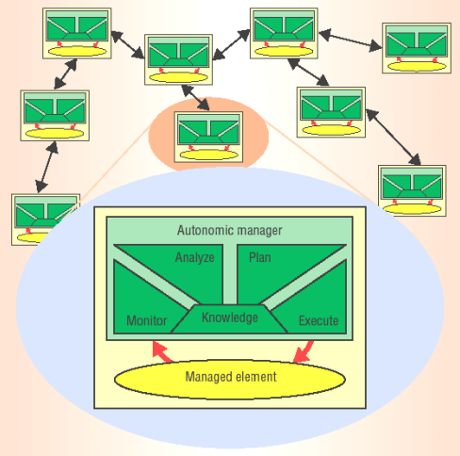
Self-Management and Control Structure of Self-Adaptive Systems
Self-*: systems shall managing themselves.
Self-tuning - performance
Self-configuring - flexibility
Self-healing - dependability
Self-protecting - security/privacy
MAPE Control Loop for Self-Adaptive System
Monitoring
Analyzing
Planning
Execution
Sensing
Actuating
+
+
knowledge
Self-Adaptive Architecture
The vision of autonomic computing (Kephart and Chess, 2003)

Slide 46
MAPE Control Loop for Self-Adaptive Architecture
Monitor
collect architecture-level events and parameters
Analysis
aggregate and reason about events/parameters
Plan
generate reconfiguration plans based on adaptation rules
Execution
architecture reconfiguration
Component-based Middleware for Self-Adaptive Architecture

Slide 47
Architecture Reconfiguration
Component replacement
with similar or identical interfaces
dynamic service selection and composition in service-oriented systems
Structure reconfiguration
add/remove components
add/remove links between components/connectors
Behavior reconfiguration
behavior of individual components
interaction behavior among components

Slide 48


Representative Research Groups (5/5)
Nanjing University
Focus: dynamically reconfigurable systems
Typical project
ARTEMIS : Agent-oRiented TEchnology and Methodology for Internet Software
Website: http://moon.nju.edu.cn/cgi-bin/twiki/view/ICSatNJU/ARTEMIS
Main publications:
FSE, ICWS, Science in China, Software: Practice & Experience, Journal of Computers, Journal of Software…

Slide 49
Smart wire
Enriched component wires based on mobile agent technology
Wiring logic
Group Table: Combination of available components.
Location Table: Locations of the components in the GT.
The GT and LT are translated into a mobile agent.
The components are wired up by the agent.

Slide 50
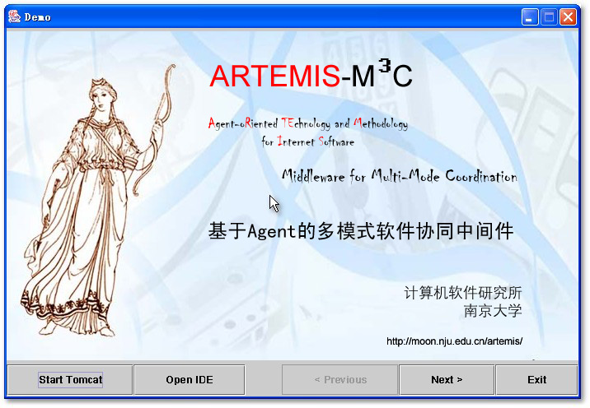
Multi-mode interaction
“Factorize” the Interaction modes into basic interaction “factors”
“Synthesize” the factors to form different interaction modes
Artemis-M³C system：
Software service integration and interaction mode configuration
Runtime support for multi-mode interaction

Slide 51
Dynamic architecture
Program the architecture as an distributed shared object.
Express the architectural style with the type of the object;
Constrain the architectural evolution with the type and inheritance mechanism of OOPL.
Support the dynamic reconfiguration
With programmed behavior of the architecture object --- Planned
With polymorphic replacement of the architecture object --- Unplanned

Slide 52
System Structure

Slide 53
Agenda
Introduction
Founding Support
Basic Research and Program
Representative Research Groups
Conclusion

Slide 54
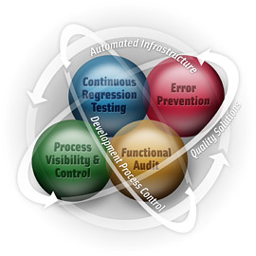
Main problems in China
Several reasons caused many problems of software development in China
Custom Requirement
Theory
Supervise
Complexity
Increasing
Developer
heterogeneity
Developer
Instability
Scale
Increasing

Slide 55

Challenges of Software
Legacy system
reasonable cost to maintain and update the system
integrate the important business information and services in the system
Heterogeneous system
Require new technology for development to run the developed software on different hardware platforms and system environments
High confidence requirements for software development
How to ensure the high confidence for software development and running?
Changing of software development
Research the architecture and development model of distributed software, explore the corresponding strategy of software engineering

Slide 56



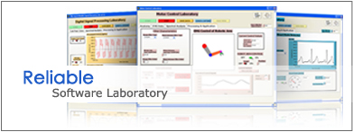




Software research in China
The NSFC major research project named ‘Basic Research on Trustworthy Software’ from 2007
Research of major colleges and universities in the future

Slide 57
Thanks for your attention!! Q & A

